Slide 1
MIS547
Cloud Computing

Slide 2
Lecture 14
Container Orchestration

Slide 3
AGENDA
What’s covered in this lecture:
Agenda
What’s covered next:
Container Orchestration
Kubernetes
Other orchestration tools and container services! Also more K8!
Intro to Kubernetes

Slide 4
Containers- Use Cases

Slide 5
Containerization Benefits
Application Isolation
Portability
Simplified deployment (hybrid, multi-cloud)
Consistency
Resource efficiency
Horizontal Scaling
Rolling Updates

Slide 6
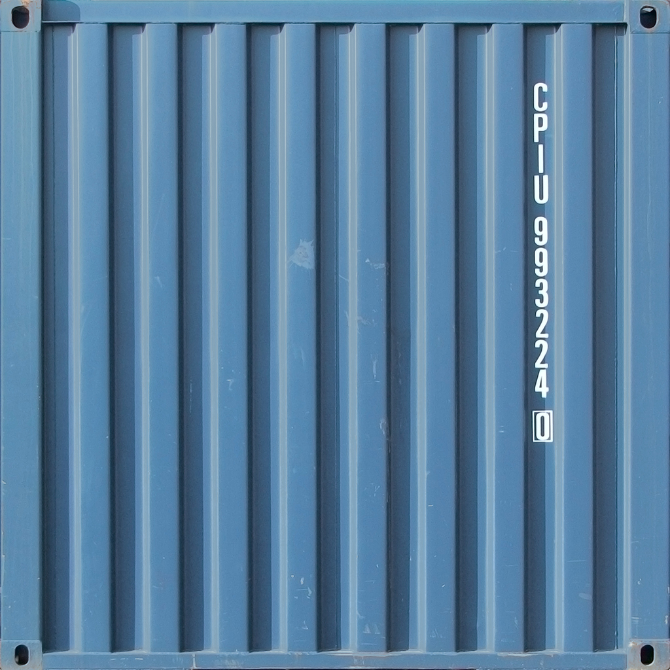
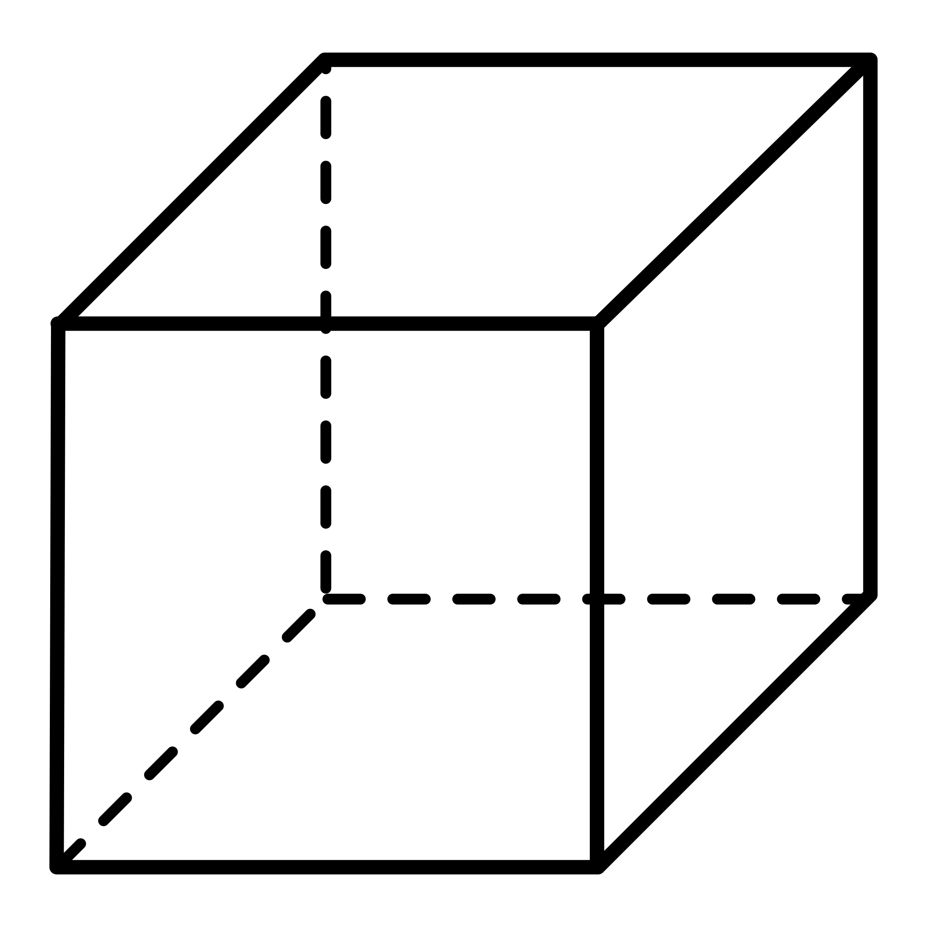
When Do we Use containers?
“Lift and shift” existing applications into modern cloud architectures
Refactor existing applications for containers
Develop new container-native applications
Provide better support for microservice architectures
Provide easier deployment of repetitive jobs and tasks

Slide 7
Managing Containerized Applications
Containerized applications can get complicated.
Hundreds to thousands of separate containers in production.
What could go wrong?

Slide 8
Distributed Applications
Most applications are bigger than one computer can handle
Gmail, Netflix
These applications are comprised of many services.
Services are distributed across multiple machines, forming a distributed application.
This requires software that is can manage all components running across these machines.
We need a “cluster OS”.

Slide 9
Why Do we use distributed applications?
Running services in containers on a single host:
Availability?
Fault tolerance?
Scale?
Resource utilization?
Upgrades?
Host Machine

Slide 10
How Do We Run Distributed Applications?
How to group hosts together to form a cluster?
How to manage these hosts as a single compute unit?
How to schedule containers to run on a specific host?
How can containers running on one host communicate with containers running on other hosts?
How to provide the container with storage and/or access to data?
How to access containers over a service name, instead of through an IP address?

Slide 11
Container Orchestration

Slide 12
Container Orchestrators
Orchestration and scheduling refer to running and managing containers across a cluster.
A cluster is a group of machines, physical or virtual, connected over a network.
Container orchestrators are like operating system on your laptop.
They manage your applications, execute them, and schedule when each app gets to use your laptop’s hardware resources.

Slide 13
container orchestration
Umbrella concept that encompasses container scheduling and cluster management.
Scheduling: driven by policy to automate decision process that distributes containers across the nodes of the cluster.
Cluster operators can control the scheduling process
Cluster management: refers to the state of the existing workload and cluster node resource availability
Manage the resources of cluster nodes, add or delete nodes through cluster scaling mechanism.
Tools: Kubernetes, Docker Swarm, Nomad, Amazon ECS

Slide 14
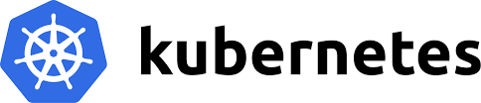
Kubernetes
The de facto container orchestrator
Automates deployment, operations, and scaling of containerized applications.
First hosted project in CNCF (2015), built by Google

Slide 15
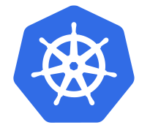
What is Kubernetes
Open source container orchestration framework
Manages containers
Helps you manage applications made up of 100s or 1000s of containers in different environments
Physical machines, virtual machines, cloud environments, hybrid environments

Slide 16
Why do we need Kubernetes?
Monolith (Traditional Application)
Increased use of container technologies
Small, independent applications (microservices)
This resulted in applications comprised of thousands of containers!
Managing this across multiple environments can be very challenging.
We need tooling that can help us → container orchestrators!
Microservice A
Microservice B

Slide 17
What Features do Orchestration Tools Offer?
High availability (no downtime)
Scalability (high performance, loads fast, users have high response rate)
Disaster recovery (backup and restore; application doesn’t loose data, application can run from latest state after the recovery)

Slide 18
How Does Kubernetes work?

Slide 19
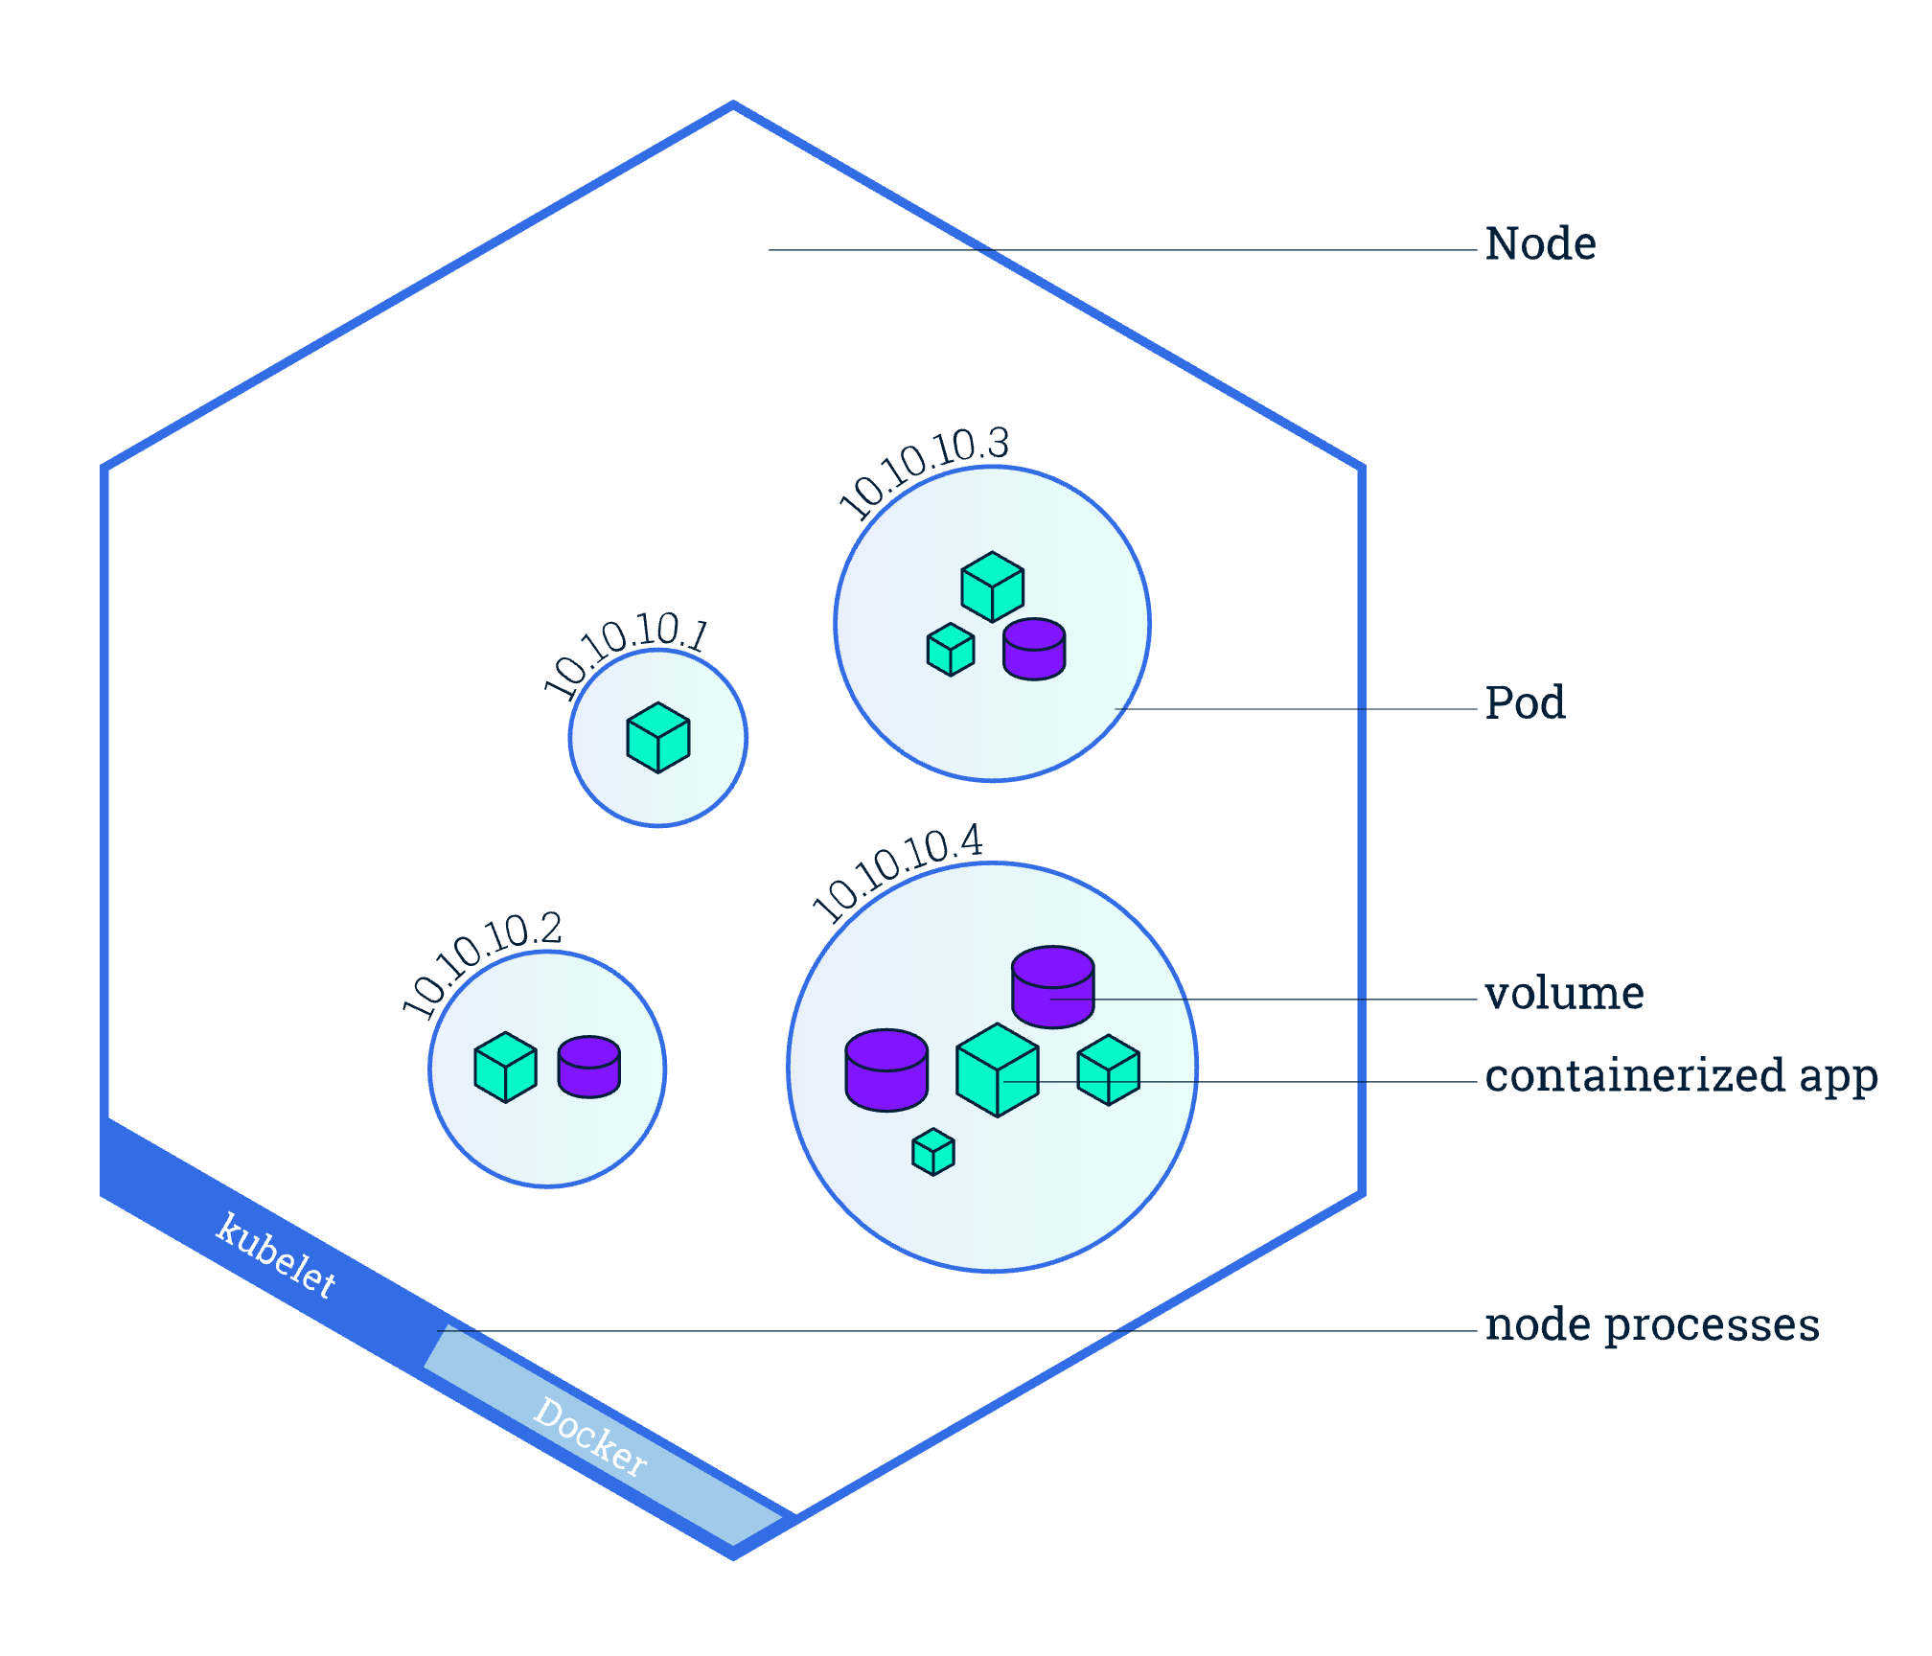
Kubernetes Components: Nodes and Pods
Node (worker node)
Physical or virtual machine
Smallest unit of K8s == pod
Pod runs one application container inside it (usually)

Slide 20
Pod
Hosts a containerized application
Smallest unit in K8s, runs on a Node
Volume: storage for our containerized application (see Assignment 3)
Networking: unique IP address
Information about how to run each container (container image version, ports to use, etc.)
Node
Worker machine
Managed by control-plane
Can have multiple pods
Runs at least:
Kubelet (process that communicates with control plane)
Container runtime (Dokcer)

Slide 21
Kubernetes Pods
Logical abstraction over container runtime
You don’t work directly with Docker, only with the K8 layer
Each pod gets its own internal IP address
Pods can talk to each other over these IP addresses
Pods are ephemeral: they can die very easily!
What might this mean for database containers?
What does this mean for the IP address?
Pod
10.0.0.2
my-app
Pod
10.0.0.3
database
Node

Slide 22
Kubernetes Services
Pod
Service:
A permanent IP address
Lifecycle of Pod and Service are NOT connected
You don’t have to change the endpoint when a pod dies!
Service
my-app
Pod
Service
database
Node

Slide 23
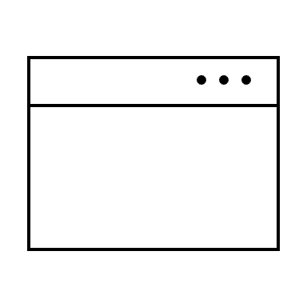
Kubernetes Services
http://my-app-service-ip:port
App needs to be accessible through browser
Use external service
Pod
Service
my-app
Pod
Service
database
Node

Slide 24
Kubernetes External Service
http://10.0.0.2:8080
External service with node IP address and service port?
Not ideal.
We want to define the service with:
Secure protocol (https)
Domain name
We use Ingress
Pod
Service
my-app
Pod
Service
database
Node

Slide 25
Kubernetes Ingress
http://my-app.com
Ingress handles forwarding to the service.
Note that the database has an internal service- it should never be exposed via an external service ☺
Ingress
Pod
Service
my-app
Pod
Service
database
Node

Slide 26
ConfigMAp and Secret
Pods communicate using a service
E.g., mongo-db-service
Where do we configure this endpoint?
Usually inside the built application
If the endpoint changed, we’d have to rebuild application with new version, push to repo, pull new image in pod and restart
Pod
Service
my-app
Pod
Service
database
Node

Slide 27
ConfigMAp and Secret
Pods communicate using a service
E.g., mongo-db-service
Where do we configure this endpoint?
Usually inside the built application
If the endpoint changed, we’d have to rebuild application with new version, push to repo, pull new image in pod and restart
K8 has a component called ConfigMap
External configuration to your application
Connect it to the pod
If service name changes, just update ConfigMap
Pod
Service
my-app
ConfigMap
Pod
Service
database
Node

Slide 28
ConfigMAp and Secret
But where do we store our DB credentials?
We use Secret
Used to store credentials and is base64 encoded
DB_USER
DB_PWD
Certificates
Connect to pod
Not enabled by default!
Can use as environmental variables or properties file as well.
Pod
Service
my-app
ConfigMap
Secret
Pod
Service
database
Node

Slide 29


Data Storage: Volumes
Remote volume
If a db container or pod is restarted, data is lost!
We use Volumes
Storage on local machine (same node) or
Remote, outside of K8 cluster
Think of volumes as external hard drive plugged into K8 cluster
K8 doesn’t manage data persistence!
Pod
Service
database
Local volume
Node

Slide 30
Deployment and ScaleSets
What happens if the application pod crashes, or we have to restart the pod because we built a new container image
Downtime ☹
Pod
Service
http://my-app.com
my-app
Pod
Service
database
Node

Slide 31
Replica Nodes
http://my-app.com
Instead of relying on one pod, we replicate everrrryyythiinnng
This is the key benefit of distributed systems!
Replicas are connected to the same Service
Persistent static IP address with DNS name
Also a load balancer!
Will forward traffic to pod that is less busy or that is available.
Pod
Pod
Service
my-app
my-app
Pod
Pod
Service
database
database
Node 1
Node 2

Slide 32
Deployment
http://my-app.com
A blueprint for my-app pods
Defines how many replicas you want to have.
In practice, you don’t create pods, you create Deployments.
Abstraction on top of Pods.
Deployment
Pod
Pod
Service
my-app
my-app
Pod
Pod
Service
database
database
Node 1
Node 2

Slide 33
What if the DB Dies?
http://my-app.com
We can’t replicate a database using a deployment.
Deployment
Pod
Pod
Service
my-app
my-app
Pod
Pod
Service
database
database
Node 1
Node 2

Slide 34
StatefulSet
http://my-app.com
For stateful apps like databases we use StatefulSet
Takes care of replicating pods and making sure db reads/writes are synchronized.
Not easy!
Common practice is to host DB outside of the cluster
Deployment
Pod
Pod
Service
my-app
my-app
Pod
Pod
Service
database
StatefulSet
database
Node 1
Node 2

Slide 35

Deployments and StatefulSet
http://my-app.com
Now if the whole node crashed, we would have a second node that would still be accessible by the user!
Deployment
Pod
Pod
Service
my-app
my-app
Pod
Pod
Service
database
StatefulSet
database
Node 1
Node 2

Slide 36
Main K8 Components
Pods: abstraction over containers
Service: persistent IP + load balancer tied to a pod
Ingress: a type of service that routes traffic into cluster
ConfigMap: configuration for services
Secrets: manages secrets like authentication credentials
Volumes: data persistence for the pod, like an external hard drive
Deployments: replicating mechanism for pods
StatefulSets: replicating mechanism for stateful components

Slide 37
Basic Kubernetes Architecture
Control Plane (used to be called ‘master node’)
Node (used to be called ‘slave’, ‘worker node’)

Slide 38
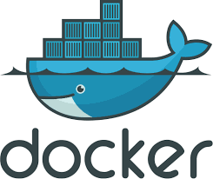
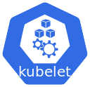
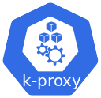
Node Processes
Worker machines in K8s cluster
Each node has multiple pods on it
3 processes on every node
Container runtime (e.g., Docker)
Kubelet (K8 process that interacts with both the container runtime and the node itself)
Starts a pod with a container inside, assigns resources to the pod
KubeProxy: forwarding logic that makes sure communication works with low overhead
Pod
Pod
Service
my-app
my-app
Pod
Pod
Service
database
database
Node 1
Node 2

Slide 39
How do we interact with the cluster?
Schedule pods?
Monitor?
Re-schedule and re-start pods?
Join new infrastructure to the cluster?
Control Plane

Slide 40
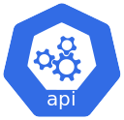
Control Plane Processes
Four processes run on every control plane
1. API server: kube-apiserver
Cluster gateway
Gets initial request
Acts as gatekeeper for authentication; 1 entry into the cluster
Use a client (UI: Kubernetes dashboard, CLI: Kubelet, or Kubernetes API) to interact with the API server
Control Plane

Slide 41

Control Plane
2. Scheduler: kube-scheduler
Start an application pod on one of the worker nodes
Decides where to put the pod based on available resources on the nodes. Factors include:
individual and collective resource requirements
Hardware/software constraints
Data locality
Kubelet gets the request from scheduler and executes that request on the node
Control Plane

Slide 42
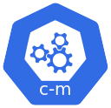
Control Plane
3. Controller manager: kube-controller-manager
Detects state changes like pods crashing
Recovers cluster state as soon as possible
Sends request to scheduler
3a. Cloud Controller manager: cloud-controller-manager
Embeds cloud-specific control logic
Control Plane

Slide 43
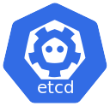
Control Plane
4. etcd
Cluster Brain!
Key-value store of cluster state, used for control plane processes to work with node processes
Every change in the cluster gets updated into etcd
But application data is not stored in etcd!
Control Plane

Slide 44
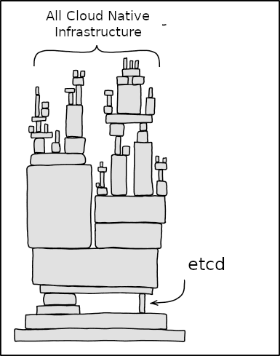
Relevant xkcd

Slide 45
Control Plane
We replicate our control plane nodes for high availability!
Control Plane 1
Control Plane 2

Slide 46
Basic Kubernetes Architecture
Control Plane 1
Control Plane 2
Control Plane 3
Pod
Pod
Pod
Pod
Pod
Pod
Pod
Node 1
Node 2
Node 3
Node 4
Node 5

Slide 47
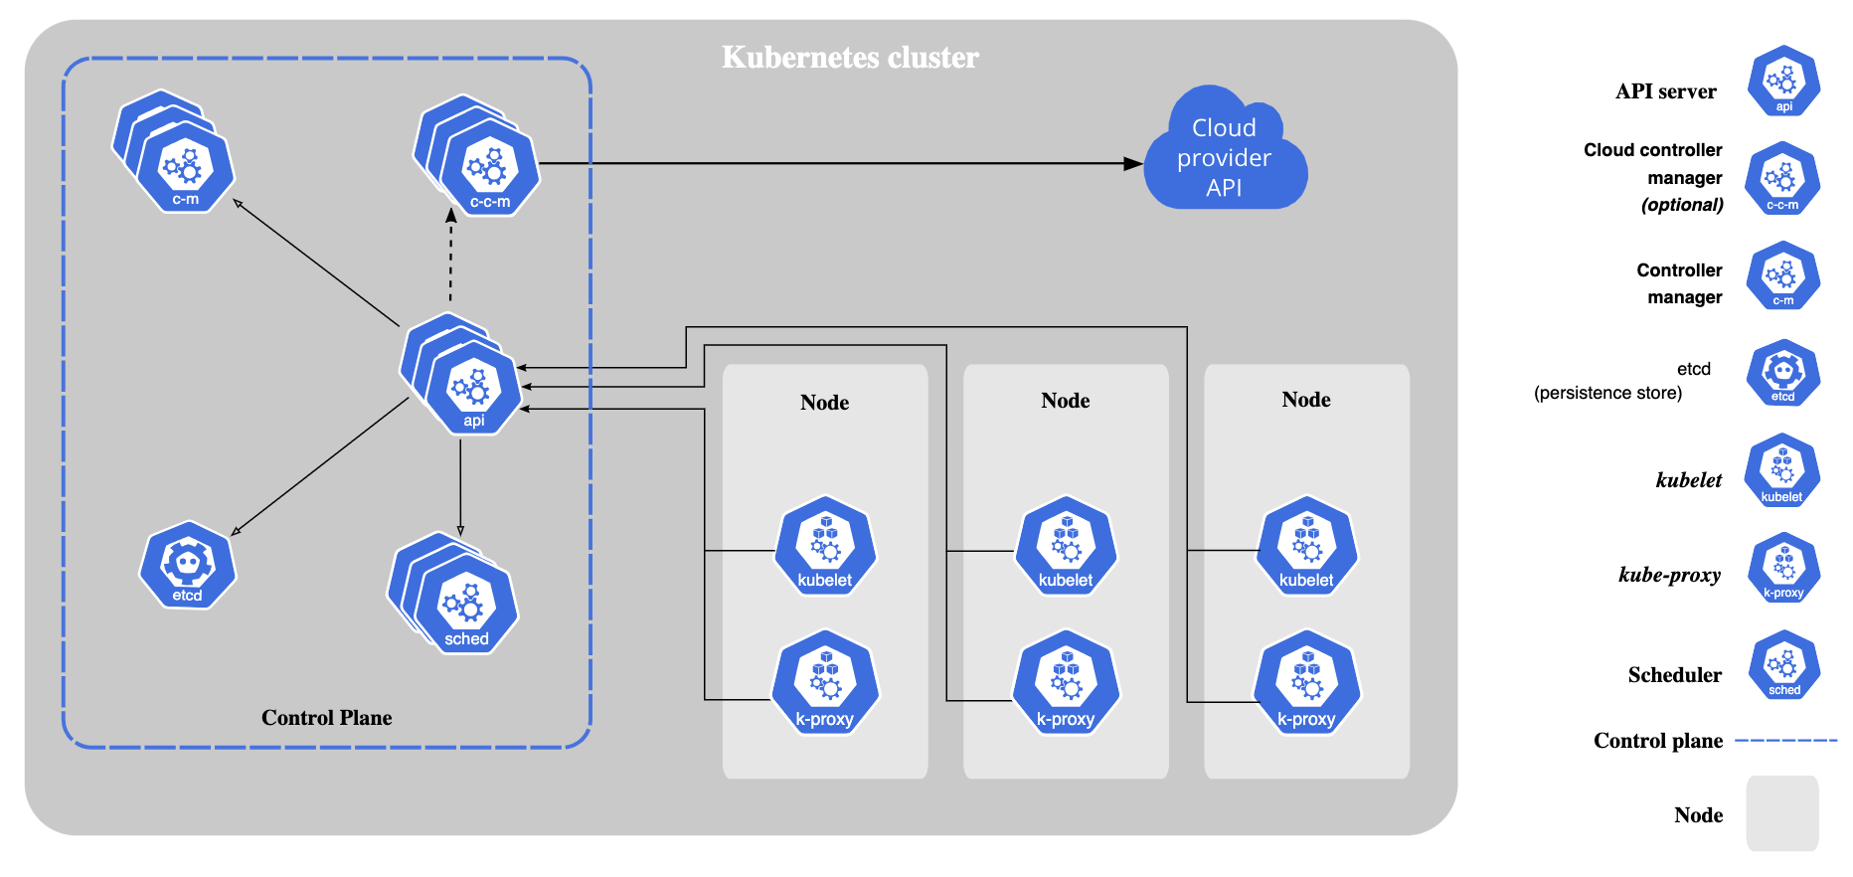
Kubernetes Architecture

Slide 48
Kubernetes Config File
apiVersion: apps/v1
kind: Deployment
metadata:
name: nginx-deployment
labels: -
spec:
replicas: 2
selector: –
template: -
apiVersion: v1
kind: Service
metadata:
name: nginx-service
spec:
selector: -
ports: -
Defined in YAML
“Human friendly” data serialization standard for all programming languages
Strict indentation syntax (like python!)
Store config file with your code or in its own git repo just for configuration.

Slide 49
Kubernetes Config File
apiVersion: apps/v1
kind: Deployment
metadata:
name: nginx-deployment
labels: -
spec:
replicas: 2
selector: –
template: -
apiVersion: v1
kind: Service
metadata:
name: nginx-service
spec:
selector: -
ports: -
3 Parts:
metadata
spec
status

Slide 50
Kubernetes Config File
apiVersion: apps/v1
kind: Deployment
metadata:
name: nginx-deployment
labels: -
spec:
replicas: 2
selector: –
template: -
apiVersion: v1
kind: Service
metadata:
name: nginx-service
spec:
selector: -
ports: -
Specs are attributes that are specific to the component you’re creating.
Status is automatically generated and edited by K8!
K8 will compare desired state and actual status of component.
Basis of self-healing features of K8
The status data comes from etcd.

Slide 51
Kubernetes
State reconciliation
Matches the current state of containers within a cluster to the desired state.
Desired state is defined by the engineer (declarative configuration management)
Kubernetes will continually monitor the desired state and compare it with the current state
If desired and actual state don’t match, Kubernetes reconciles them by creating or destroying objects.

Slide 52
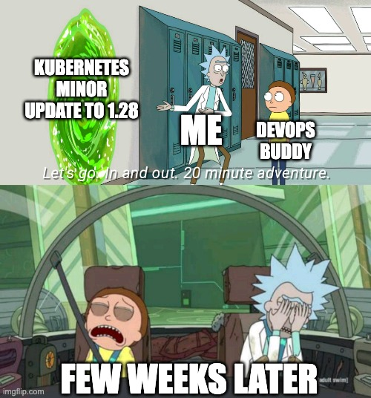
Kubernetes
Allows you to treat a cluster as one computer.
You as the developer focus only on what the environment should look like and handles the implementation for you.
You as the DevOps Engineer, or SRE, or Architect are in for a wild ride.

Slide 53
Benefits of Using Kubernetes
Open Source system
Packages all the necessary features (orchestration, service discovery, load balancing)
Manages multiple containers at scale
Automates deployment, scaling, operations of application containers
Portable, extensible, self-healing
Consistency across dev, testing, prod environments, on-prem and across public clouds
Highly efficient with resource utilization

Slide 54
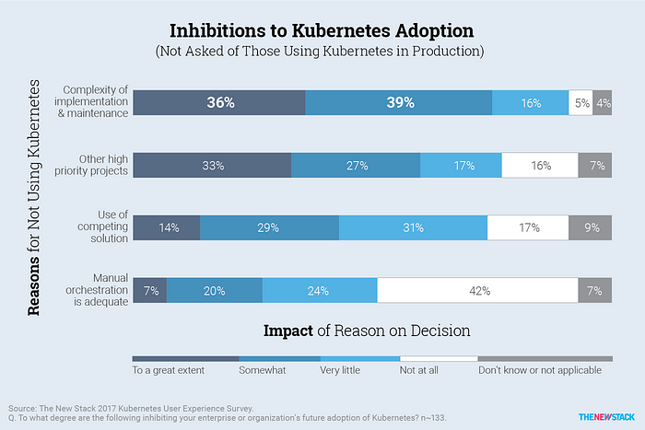
Inhibitions to Kubernetes Adoptions

Slide 55
Kubernetes Hosted Solutions and Platforms
Can self-manage our own cluster in the public cloud or opt for hosted Kubernetes services
Amazon Elastic Kubernetes Service (Amazon EKS)
Azure Kubernetes Service (AKS)
Google Kubernetes Engine (GKE)
DigitalOcean Kubernetes Service (DOKS)
RedHat OpenShift

Slide 56
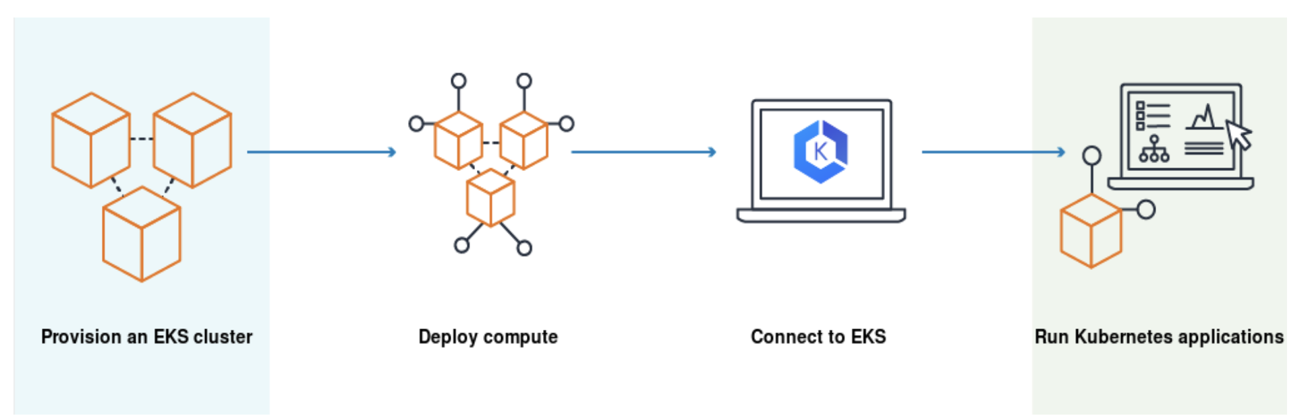
Amazon Elastic Kubernetes Service
Scalable and highly-available control plane that runs across multiple AWS AZs.
Can automatically detect unhealthy Kubernetes control plane nodes and replace them
Supports cluster autoscaling, dynamically add worker nodes into the cluster based on workload and resource utilization
Integrates with Kubernetes Role-Based Access Control (RBAC) to support AWS IAM authentication

Slide 57
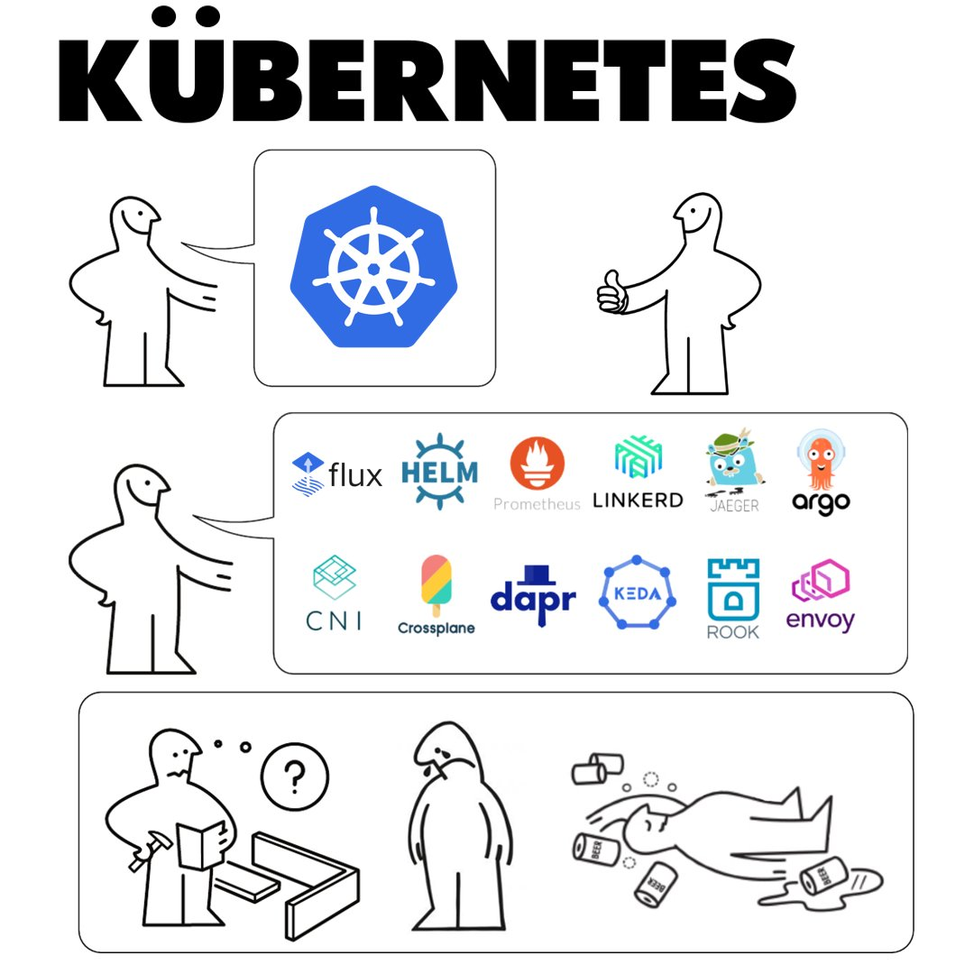
Why use Managed service??

Slide 58
Kubernetes Architecture Key Components
Cluster: A collection of systems (bare-metal or virtual) and other infrastructure resources used by Kubernetes to run containerized applications.
Control-Plane Node: a system that takes containerized workload scheduling decisions, manages the worker nodes, enforces access control policies, and reconciles changes in the state of the cluster.
kube-apiserver
etcd
kube-scheduler
kube-controller-manager
Coordinate tasks around container workload scheduling, deployment, scaling, worker node agents
Multiple control-plane nodes may be found in clusters as a solution for High Availability.

Slide 59
Kubernetes Architecture Key Components, Cont.
Worker Node A system where containers are scheduled to run in workload management units called Pods. The node runs a daemon called kubelet responsible for intercepting container deployment and lifecycle management related instructions from the kube-apiserver, delegating such tasks to the container runtime found on the node, implementing container health checks, enforcing resource utilization limits, and reporting node status information back to the kube-apiserver. kube-proxy, a network proxy, enables applications running in the cluster to be accessible by external requests. Both node agents - kubelet and kube-proxy, together with a container runtime are found on worker nodes and on control-plane nodes as well.
Namespace The namespace allows us to logically partition the cluster into virtual sub-clusters by segregating the cluster's resources, addressing the multi-tenancy requirements of enterprises requiring an isolation method for their projects, applications, users, and teams.

Slide 60
LAND ACKNOWLEDGEMENT STATEMENT
We respectfully acknowledge the University of Arizona is on the land and territories of Indigenous peoples. Today, Arizona is home to 22 federally-recognized tribes, with Tucson being home to the O’odham and the Yacqui. Committed to diversity and inclusion, the University strives to build sustainable relationships with sovereign Native Nations and Indigenous communities through education offerings, partnerships, and community service.

